Slide 1
Father Connection and Support in Adulthood
How a Subjectively Close Father Might Influence Adult Social Networks
Christopher Soria

Slide 2
Introduction
Literature Review, Hypotheses, Theory

Slide 3
Literature Review: Fatherhood Research
Father presence produces positive outcomes^{1,2}
Quality of Presence
Direct and/or a unique impact on children by the father is scarce.
The father is crucial to socialization and personality development
But why and how?^{3,4}
Lots of research on children, less on adults⁵
Fatherhood impact on children’s personal networks⁶
1. Brown et al., 2009 2. Mitchel et al., 2007 3. Lamb, 2010 4. Pleck, 2007 5. Sharabany, Scher & GalKruz, 2006 6. Roopnarine et al, 2006

Slide 4
Theory: Attachment Theory
If the individual feels “attached” to a figure (loved, secure), they are more likely to behave in a confident way, explore their environment and interact with others in their community.^{1,2,3}
“secure base”
Infants who achieve secure attachment with their parents are more likely to establish relationships with others.⁴
Attachment behaviors continue to exist throughout the life course.^{5,6}
Parental attachment and its significance in adults is an area which requires further research.⁷
Secure Base
Explore the World
Meet new people
Experience rejection or failure
Seek Reassurance
1-3. Bowlby, 1969, 1980, 1988 4. Benoit, 2004 5-6. Fraley & Spieker, 2003a, 2003b 7. Fraley & Shaver, 2000

Slide 5
Theory: Social Capital
Operates at the level of the family and involves the passing down of behaviors which promote cognitive-social development-- among other things.¹
Positive engagement and warmth from the parent are both likely to lead to social capital.²
“Parental socialization social capital” vs “parental community social capital.”³
Close Father
Introduces to People He Knows
Introduces to Social Skills
Parental Socialization Parent Community Capital
The Social Skills He Teaches Are Good For Acquiring Friends Like Him
The People he Introduces Children to Are Like Him
A More Robust Social Network With More People That Are Like The Father⁴
1. Coleman, 1988 3. Entwisle & Astone,1994 3. Pleck, 2010 4. McPherson, et al, 2001

Slide 6
Study Hypotheses
Hypothesis 1: A Close Father is associated with a higher number of total social companions
Hypothesis 2: A Close Father is associated only with a higher number of male social companions

Slide 7
Methods
UCNets, Social Companions , Father Conceptualization, Dependent Variables, Model/Variable Structure

Slide 8


UCNets
The UC Berkeley Social Networks Study, or “UCNets” is a five-year panel study funded by the National Institute on Aging.
Responses were collected in 2015. The survey collected data on 1159 people in two cohorts – 21-30 year-olds and 50-70 year-olds living in the S.F. Bay Area.
Data on social networks was collected by asking respondents name-eliciting questions on the types of relationships they had.

Slide 9
Social Network
Respondents were asked how often they engaged in certain activities.
Social activities, confide in others, seek advice from others, ask for help, etc
Each respondent was asked name-eliciting questions based on what types of activities they engaged in with people in their lives.
Social Companion: People to go out to concerts, plays, clubs, sports, or other events with.
Confidant: People to discuss personal matters that come up, like issues about relationships, important things in life, difficult experiences.
Advice Giver: People you have to make important decisions – for example, about taking a job, family issues, or health problems.

Slide 10
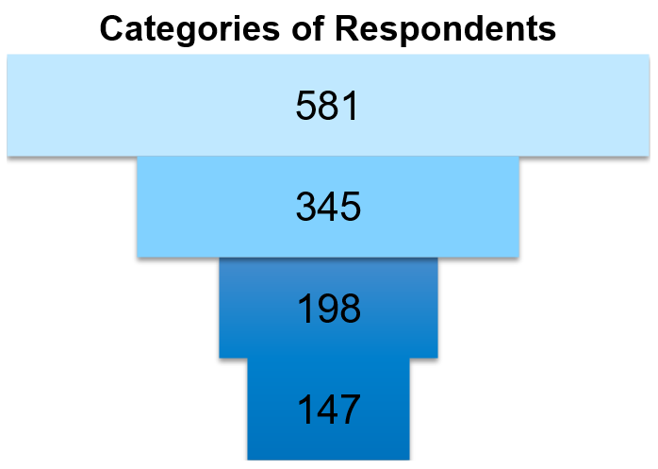
Father Conceptualization
Respondents were then asked to describe the people they named
Is the person you named a parent? What is their gender?
Were they someone they felt “especially close to?”
Is your father still alive?
Fathers are whomever the respondent considers to be “father.”
Respondents Who Reported Having a Father Who Was Alive
Named Their Father in the Study—Present
“Close” Father
Non “Close” Father

Slide 11


Independent Variables
1
2
3
People who named a father and also described him as being “especially close”
People who named a father but did not describe him as being “especially close”
People who did not name a father in their network, but reported that he was still alive.
n=198
n=147
n=247
N= 592

Slide 12
Dependent Variables
Each respondent was asked name-eliciting questions based on what types of activities they engaged in with people in their lives.
The total amount of people the respondent named as someone they engaged in social activity with, confided in and received advice from to create three respective dependent variables.
Males and Females broken out onto their own lists
Parents removed from these lists
Social Companions
Males Social Companions
Female Social Companions
Example, Social Companions *
* The same was done for confidants and advice giving ties. The result was 6 dependent variables (Confidants, Male Confidants, Female Confidants, Social Companions , Male Social Companions , Female Social Companions , Advice-Givers, Male Advice-Givers, Female Advice-Givers.

Slide 13
Dependent Variables cont.
All Social Companions
Parental Social Companions
Social Companions Beyond The Parents
6,539
201
6,338
Male Social Companions
Father Social Companions
Social Companions Beyond Fathers
2,622
70
2,552
Female Social Companions
Mother Social Companions
Social Companions Beyond Mothers
3,906
131
3,775

Slide 14
Model and Variable Structure
General Linear Model
In SPSS, known as the UNIANOVA
Close Father is categorical
Close Father
Father Named, Not Close
Father Alive, Not Named
Controlled for Race, Income, Education, etc
Weighted the sample
Controlled for physical distance from Father
Controlled for network altering events^{1,2,3,4,5}
Father Named, Not Close
Father Alive, Not Named
Close Father
1. Back, Schmukle, & Egloff, 2008 2. Shaver, Furman, & Buhrmester,1985 3. Bost, Cox, Burchinal, & Payne, 2002 4. Power & Parke,1984 5. D. R. Brown & Gary, 1985

Slide 15
Results
Descriptive, General Models, Sex-Specific Models

Slide 16
General Models: Social Companions
The Close Father category is significant in relation to people who named a father but didn’t consider him “especially close.”
Variables | Beta | Std. Error | 95 % CI
Father Not Close | . | .
 | .
Father Close | 0.628 | 0.319 | .002 | 1.26
 | (.049)**
Father Not Named | -0.319 | 0.286 | -.882 | .244
 | (.266)
Mother Not Close | . | .
 | .
Mother Close | -0.013 | 0.295 | -.592 | .566
 | (.964)
Mother Not Named | -0.195 | 0.325 | -.833 | .442
 | (.548)
Male | -0.458 | 0.210 | -.871 | -.044
 | (.03)**
Note: P Values *** p<0.01, ** p<0.05, * p<0.1
Weighted Least Squares Regression - Weighted by wt_w1_dem_95_inf

Slide 17
General Models: Social Companions cont.
Respondents in the “Father Close” category have more Social Companions than average
Overall Sample 5.63

Slide 18
Male Social Companions
Respondents in the “Father Close” category have more male Social Companions compared to people who named a father but don’t consider him close
Variables | Beta | Std. Error | 95 % CI
Father Not Close | . | .
 | .
Father Close | 0.667 | 0.219 | .237 | 1.098
 | (<.01)***
Father Not Named | -0.319 | 0.197 | -.460 | .313
 | (.710)
Mother Not Close | . | .
 | .
Mother Close | 0.094 | 0.203 | -.304 | .492
 | (.644)
Mother Not Named | 0.030 | 0.223 | -.409 | .468
 | (.895)
Male | 1.234 | 0.415 | .950 | 1.518
 | (<.01)***
Note: P Values *** p<0.01, ** p<0.05, * p<0.1
Weighted Least Squares Regression - Weighted by wt_w1_dem_95_inf

Slide 19
Male Social Companions cont.
Respondents in the “Father Close” category have more male Social Companions than average
Overall Sample 2.38

Slide 20
Female Social Companions
The Close Father variable produces no significant results when using female social companions as a dependent variable
Variables | Beta | Std. Error | 95 % CI
Father Not Close | . | .
 | .
Father Close | -0.042 | 0.230 | -.492 | .409
 | (.857)
Father Not Named | -0.256 | 0.206 | -.661 | .149
 | (.214)
Mother Not Close | . | .
 | .
Mother Close | -0.116 | 0.212 | -.533 | .301
 | (.584)
Mother Not Named | -0.229 | 0.234 | -.688 | .230
 | (.895)
Male | -1.680 | 0.151 | -1.98 | 1.382
 | (<.01)***
Note: P Values *** p<0.01, ** p<0.05, * p<0.1
Weighted Least Squares Regression - Weighted by wt_w1_dem_95_inf

Slide 21
Female Social Companions cont.
The Close Father variable produces no significant results when using female social companions as a dependent variable
Overall Sample 3.24

Slide 22
Conclusion
Summary, Essential vs Important, Theoretical implications, Discussion

Slide 23
Summary
Close Fathers are associated with more male Social Companions
Subjective closeness, not presence
Beyond physical distance
Beyond the mother
Fathers are essential or important?
The father produces unique outcomes relative to the mother
Close Fathers are also associated with more male confidants
Close Mothers are associated with more female confidants

Slide 24
Discussion/Limitations/Future Research
Direction of the association?
What is it about closeness?
Theoretical framework: Social Capital works best
The Father passes down unique social capital
Stronger social networks, better outcomes^{1,2,3,4}
Father-Specific Parent Community Capital⁵
Father-Specific Parental Socialization Capital
1. Hold-Lunstad et al, 2015 2. Child, Lawton, 2019 3. Gee, Jones, Burke, 2017 4. Phelps, Heidl, Wadhwa, 2012 5. McPherson, et al, 2001
Thank you to: Mao-Mei Liu, Claude Fischer, Leora Lawton, Stephanie Child

Slide 25
Hypotheses: Are Fathers Essential?
Essential Father Hypothesis: A father, because of his gender, makes unique contributions that a mother does not.
Important Father Hypothesis: A father can significantly affect child outcomes but can be “replaced” by a female figure.
From both perspectives, positive father contributions need not come from a biological father.¹
From both perspectives, the father effect is direct, not explained as the consequence of factors such as his contribution to income.^{2,3}
1. King, Thorsen, Amato, 2014 2. Biblarz & Raftery, 1999 3. Hannighofer, Foran, Hahlweg, Zimmermann, 2017

